Slide 1

How to Make a Hit
The Music of Today for the Listening of Tomorrow
By: Kyle Conway, Lindsay Hopewell, Jueting Xu, and Vishwa Angampalli
Notes:
Hello everyone and welcome to our presentation! We are going to help you make a hit by using the music of today for the listening of tomorrow. Our team consists of Kyle, myself, Jueting and Vishwa.

Slide 2

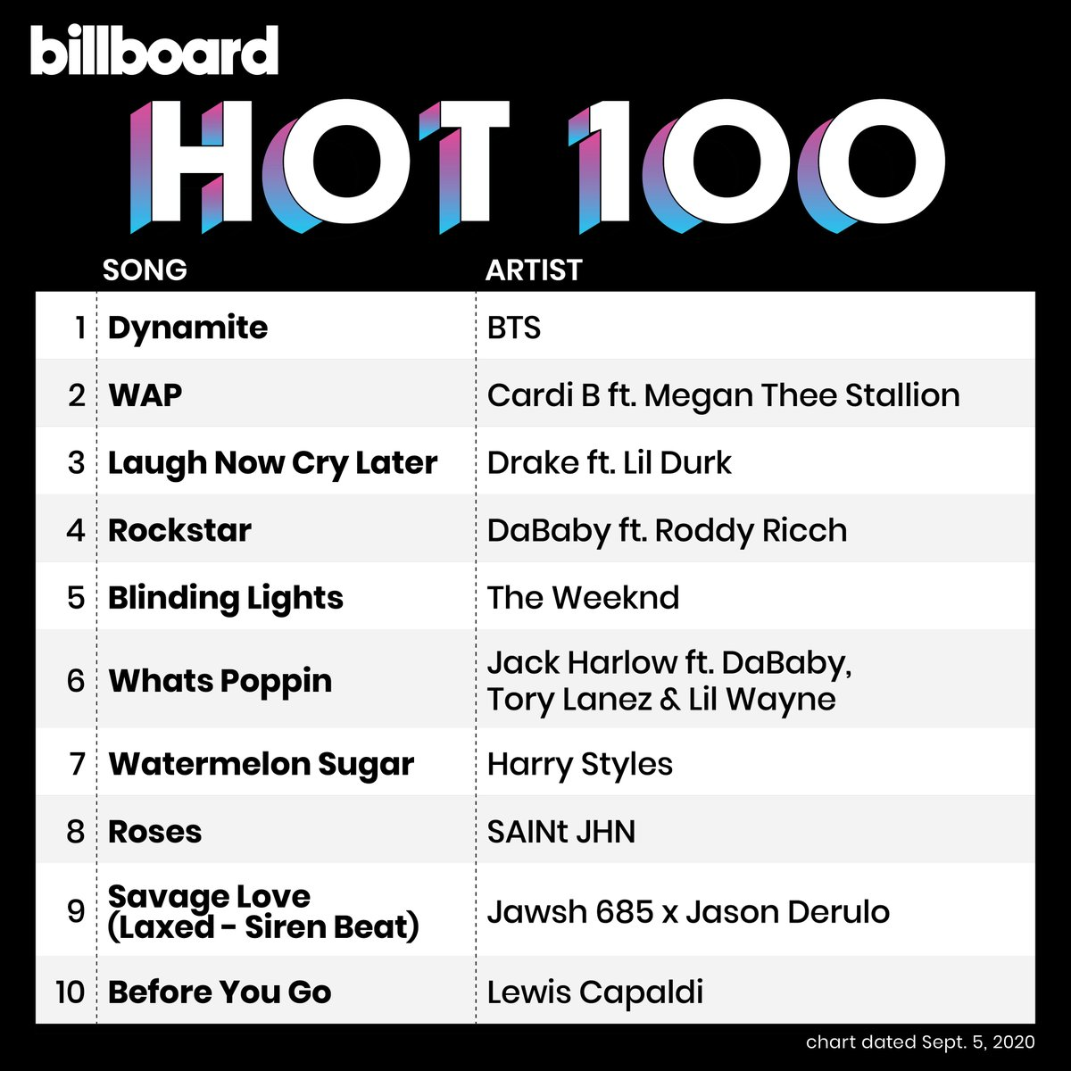
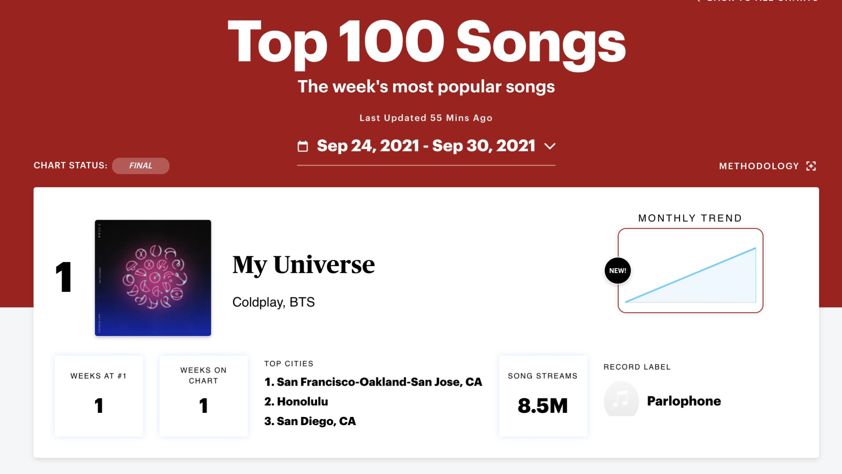
The Goal:
Using data compiled from the music application Spotify we will focus on analyzing what song features can be isolated and configured to predict the popularity of a given record.
Notes:
The goal of our project is to create a machine learning model that can be used to predict the popularity score of a song based on its features. This will allow for producers and businesses alike to input an array of features and then receive a score back.
Music has gotten more complicated with new genres coming up like escape room and bro step so we are looking to streamline the features of songs to see what will be popular based on features regardless of genre.

Slide 3
Sources:
Spotify-Data 1921-2020 | Kaggle
A compilation of over 160,000 songs from 1921-2020 with scores for various song features and a popularity score from 0-100.
Due to the range of songs and years, we used this dataset to train our model.
Top Spotify songs from 2010-2019 - BY YEAR | Kaggle
603 of the most popular songs from the last decade on Spotify as of 2020.
This was used to as our testing model to gauge our accuracy.

Slide 4
Common Features Available for Machine Learning:
Acousticness
Danceability
Duration
Energy
Liveness
Loudness
Speechiness
Tempo (BPM)
Valence
Year
Popularity
Notes:
Energy- The energy of a song - the higher the value, the more energtic. Song
Danceability - The higher the value, the easier it is to dance to this song.
Loudness..dB.. - The higher the value, the louder the song
Liveness - The higher the value, the more likely the song is a live recording
Valence - The higher the value, the more positive mood for the song.
Acousticness.. - The higher the value the more acoustic the song is.
Speechiness - The higher the value the more spoken word the song contains.
Popularity- The higher the value the more popular the song is.

Slide 5
Data Cleaning:
Analysis of Datasets for Machine Learning Purposes vs. Data Manipulation
Elimination of String Columns
Columns with a distinct name for each column were eliminated due to the overwhelming number of songs
later experimentation did leverage the genre column while testing models with some success
Reconciling the value ranges, prioritizing to a 0 to 1 range
Converting Popularity to a Binary Value using over 50 as popular per some literature found on the Spotify scoring system*
*Spotify Popularity Index: A Little Secret to Help You Leverage the Algorithm

Slide 6
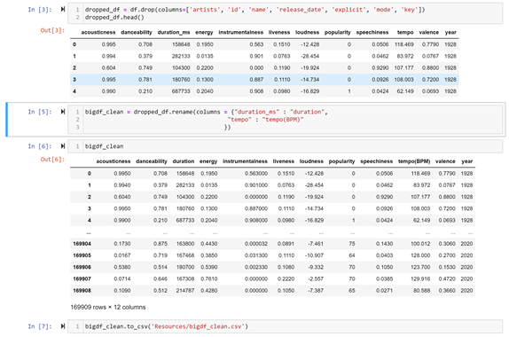
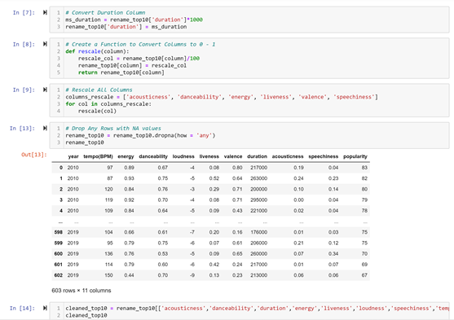
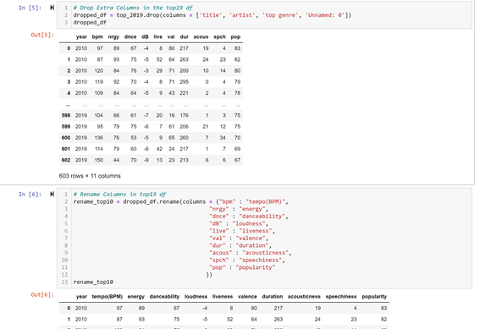
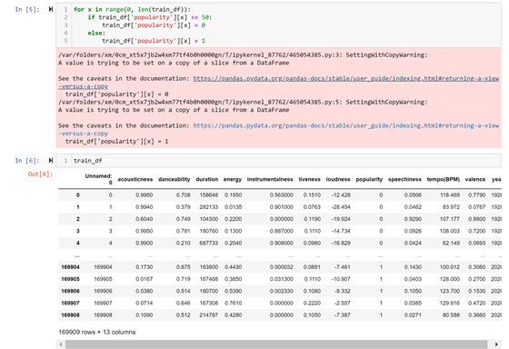

Slide 7
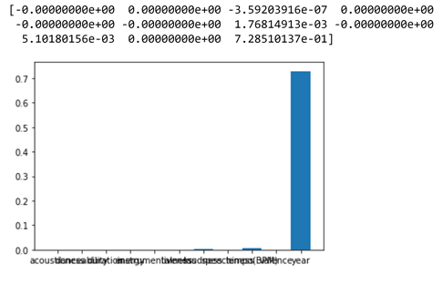
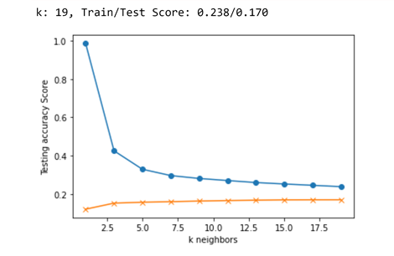
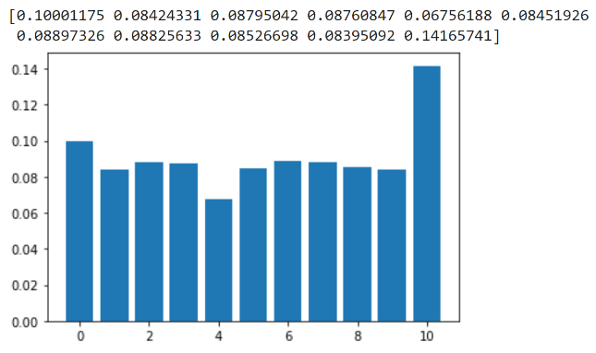
Challenges
Ensuring accuracy in feature order for training vs. testing data
Supervised learning models showed low training and testing scores
Random forest was able to predict better than linear regression and logistical regression vis a vis the high training score, but gave a very low testing score
Acousticness, Danceability, Duration, Energy, Instrumentalness, Liveness, Loudness, Speechiness, Tempo(BPM), Valence, Year
Duration, Loudness, Tempo(BPM), Year

Slide 8
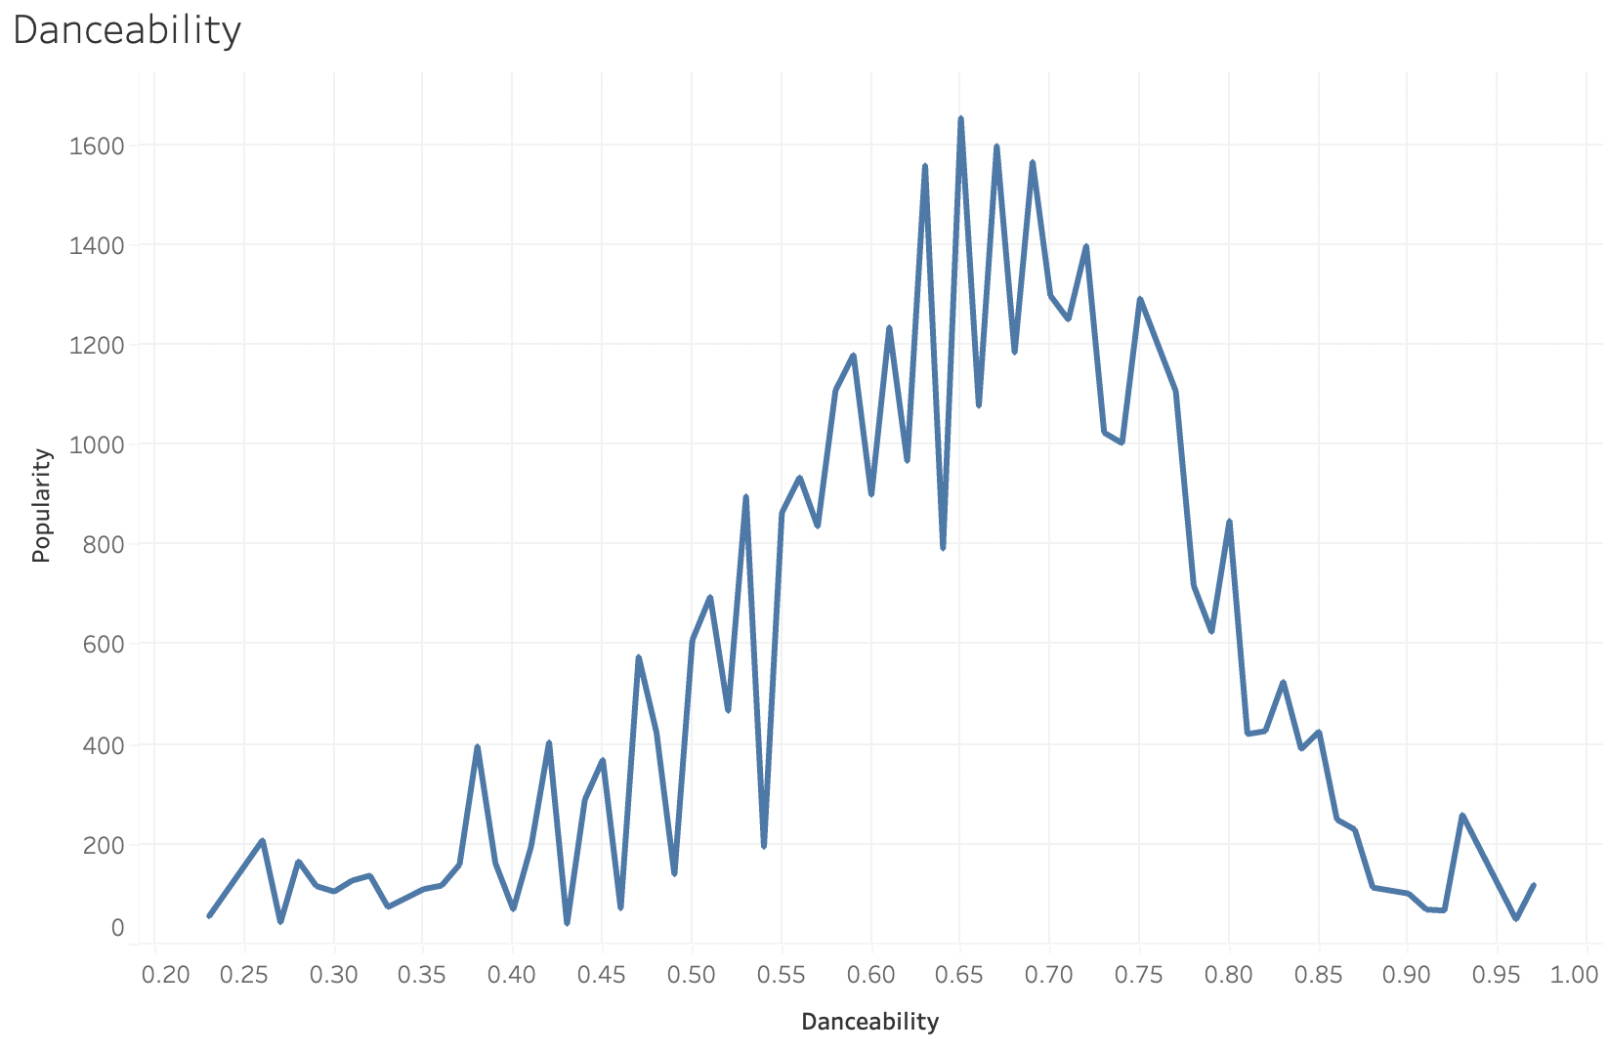
Notes:
The data isn’t simple because music isn’t simple so we needed something more complex to quantify it.

Slide 9
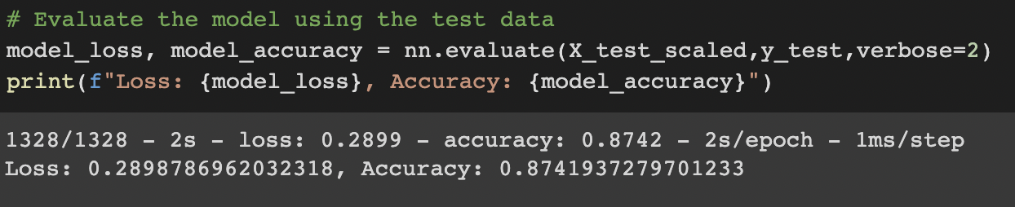
The Next Attempt: A Neural Network Predictive Model
After Linear Regression provided poor testing accuracy, we next plugged the features of our large data set into a neural network, which produced a much more successful accuracy score.
Notes:
The hyperparameters for this model were set with three layers. The first layer had ten units, the second fifteen, and the output layer of course had one. We ran the model using the Relu activation function for a total of 100 epochs These variables resulted in a total of 799 parameters for the model and returned an accuracy score of 87%.

Slide 10
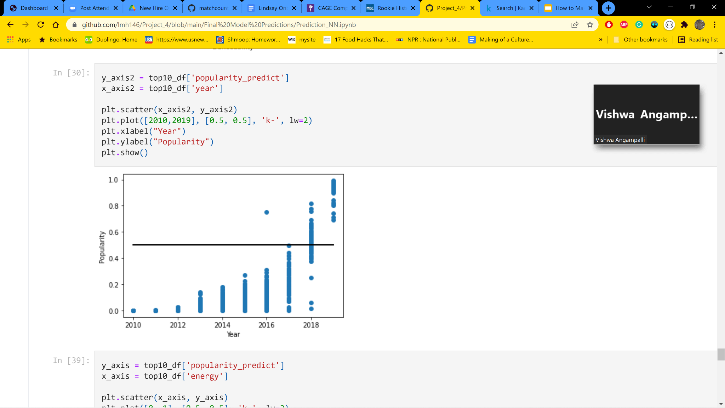
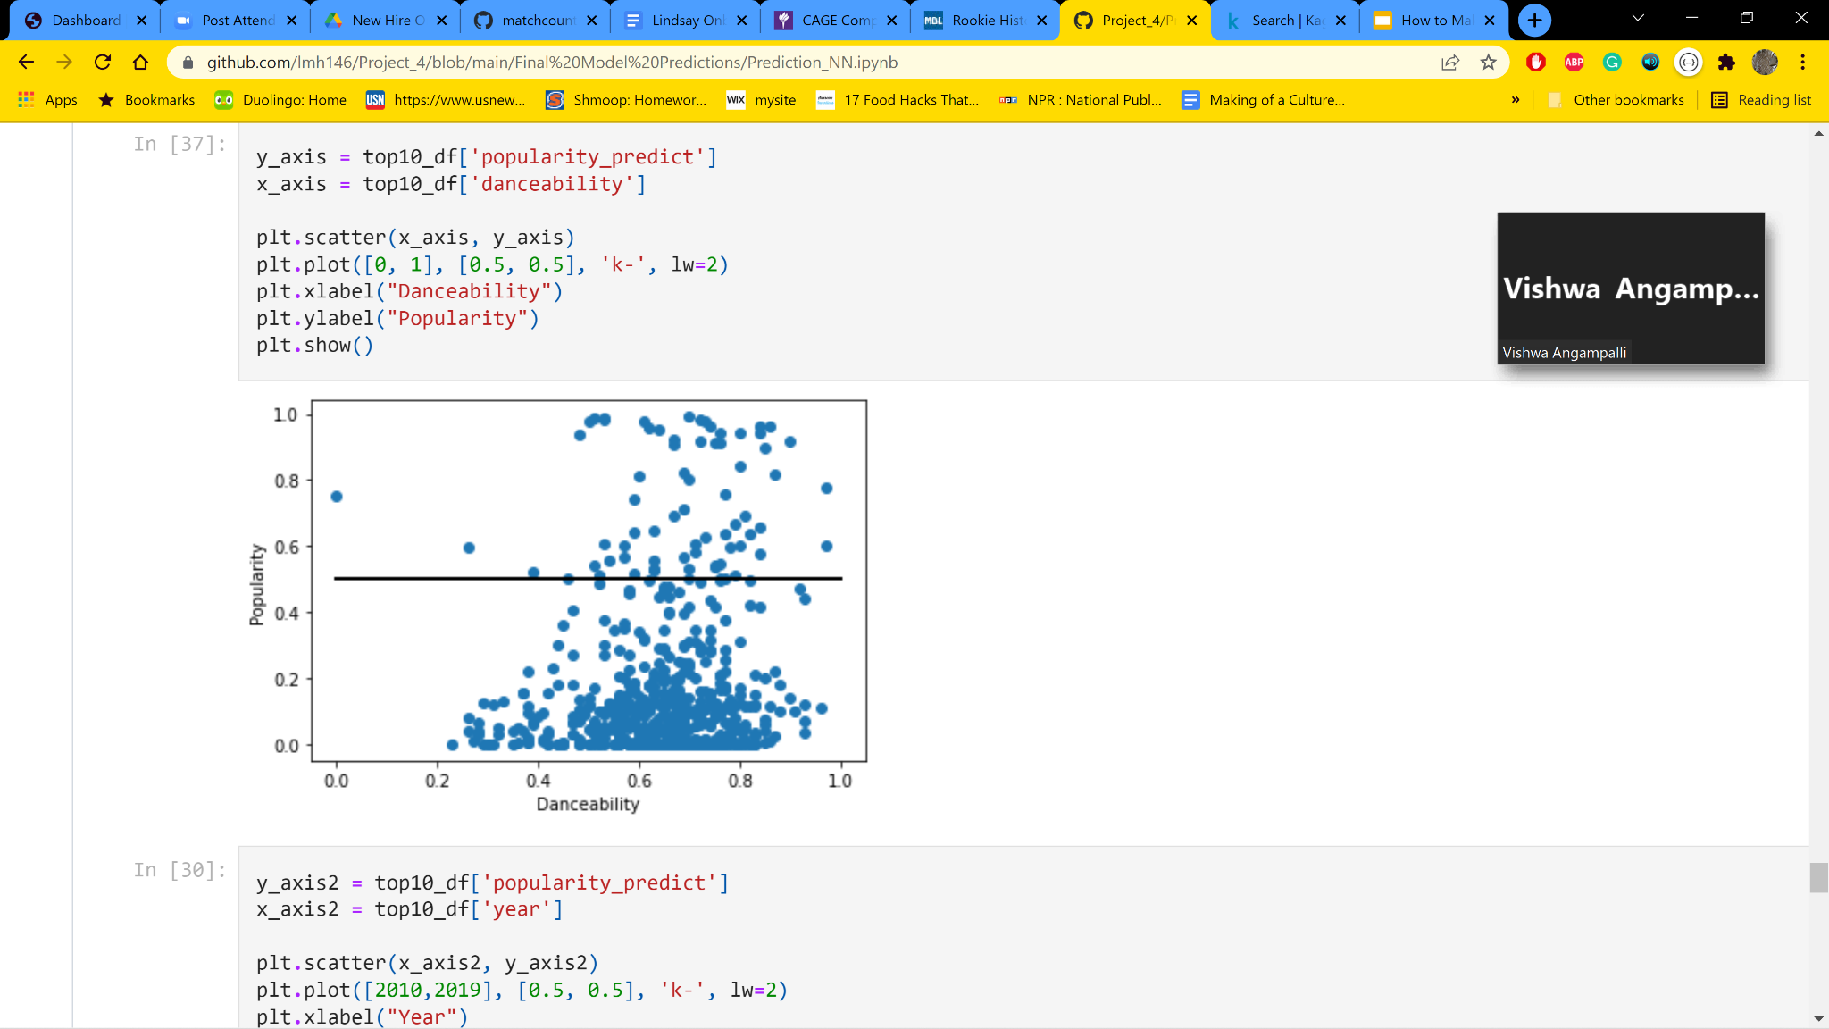
Neural Network Predictions With Year
The year variable was the feature with the strongest influence over popularity.
Predicting off of it allowed us to check the functionality of our model.
Later years = More popular
Notes:
This model was then fitted and used to predict the popularity of our testing data set. We stored the predictive popularity and graphed it based on various features using MatPlot to judge for ourselves how accurately the model predicted popularity.
Year was a strong indicator of the popularity of the song which logically makes sense given the way in which the data set was compiled (popularity as of 2020). Year was the most linear of the features (the later the year, the more popular the song with some consistency.

Slide 11
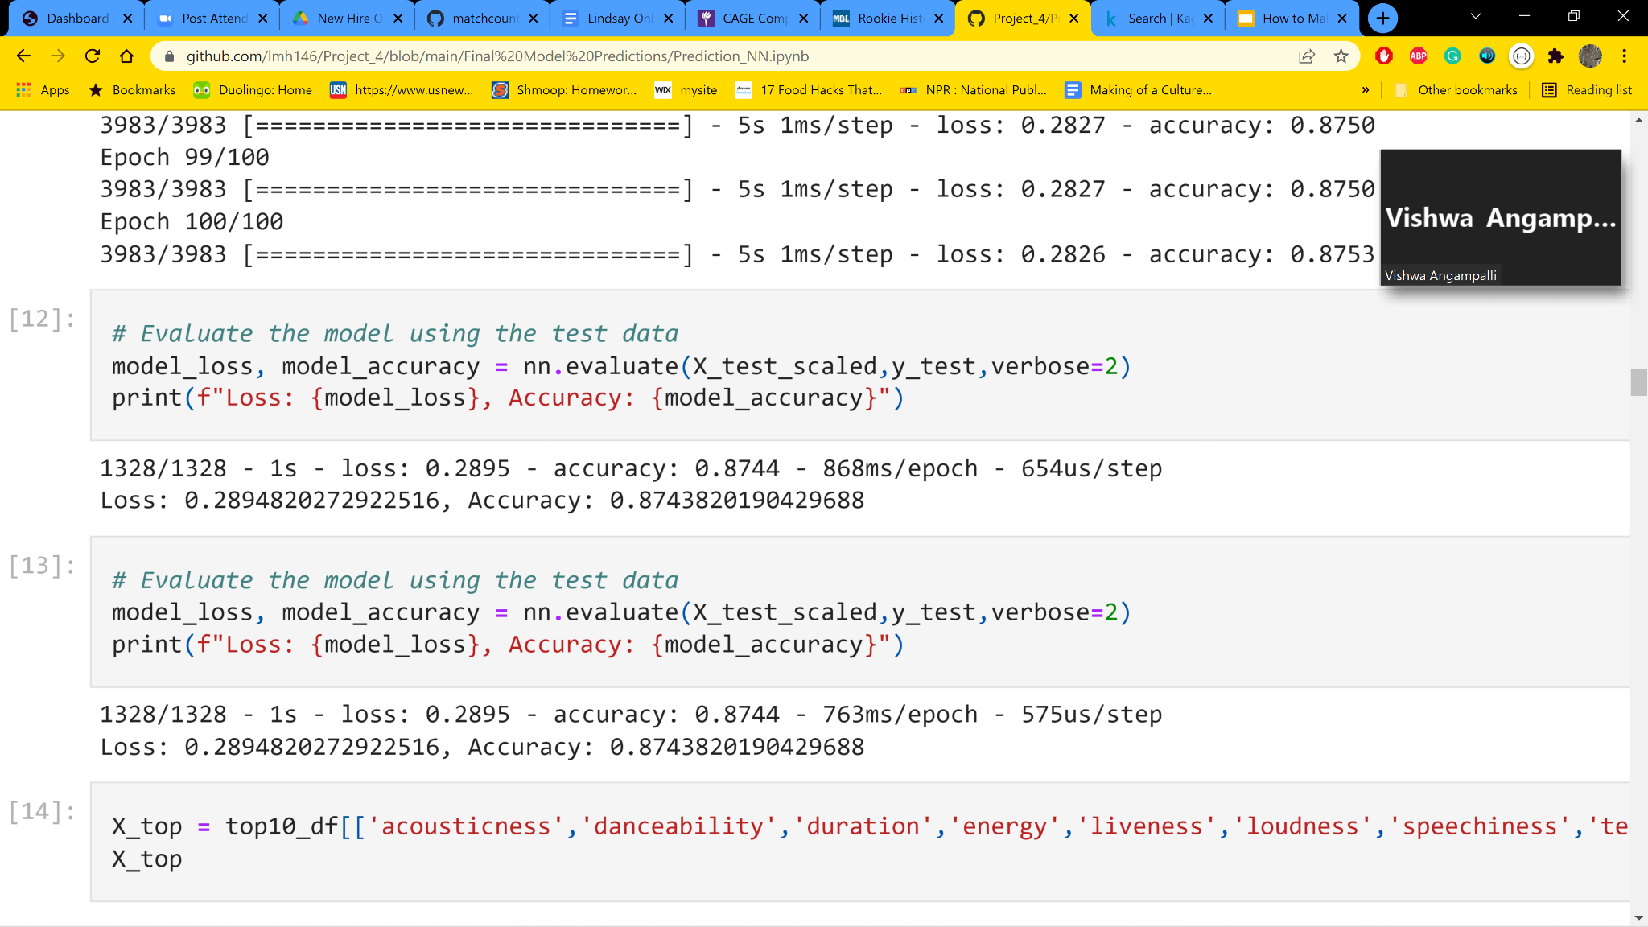
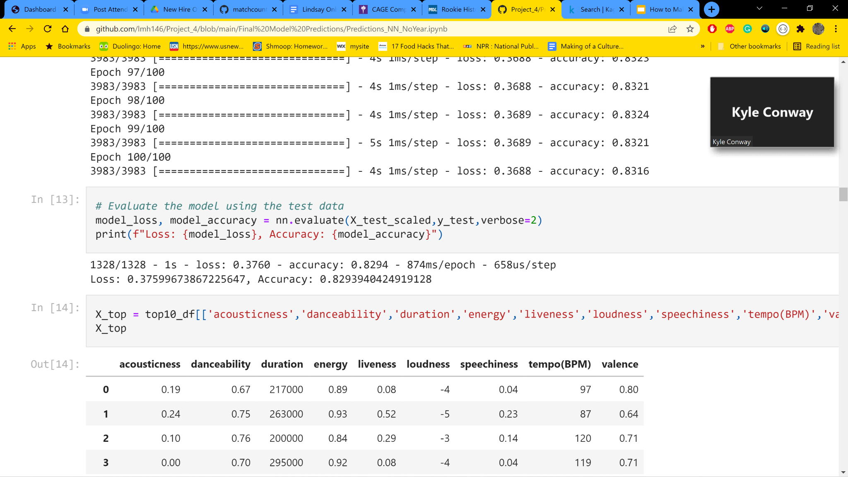
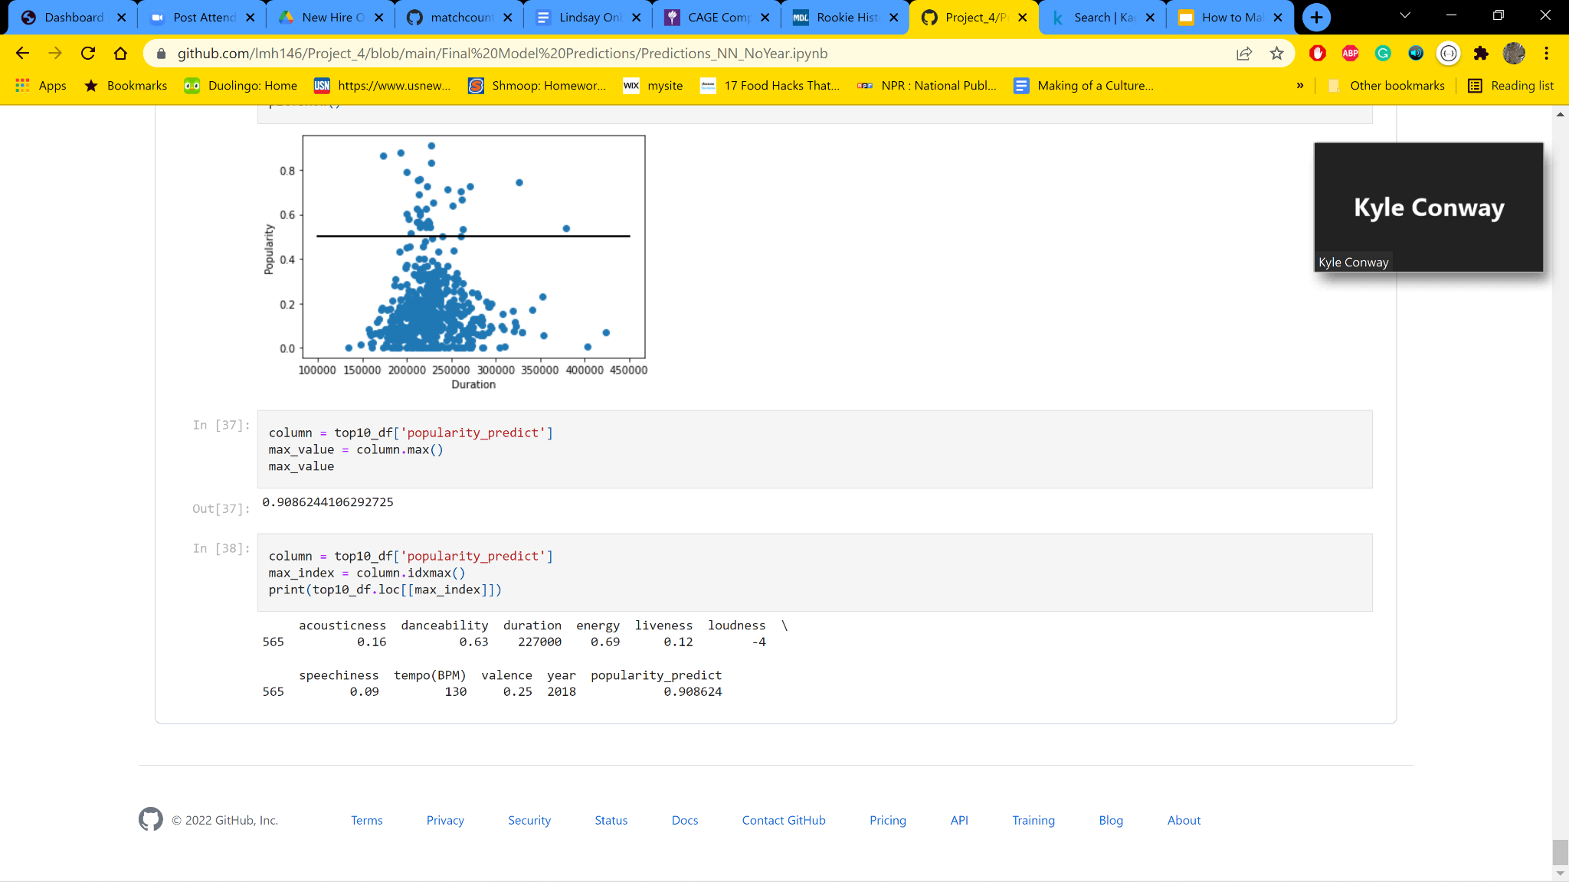
Neural Network Predictions Without Year
The year variable could hinder future application of the model.
Without year accuracy was lower but still significant.
Max popularity score:
With Year
Without Year
Notes:
The year variable could potentially hinder future applications and so we did run a version of the network without inputting year as a feature which returns a lower accuracy score, but a score that was still statistically significant.
We then set about graphing various features from our predictive models and comparing them to the trends we saw using simple data manipulation in Tableau. The trend we noticed for most features was that the highest popularity occurred at the peak of a type of bell curve, with a large number of songs before and after the given feature score.

Slide 12
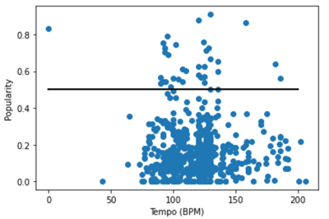
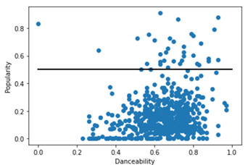
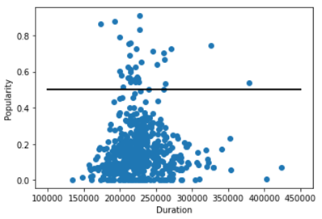
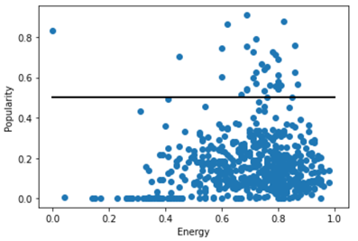
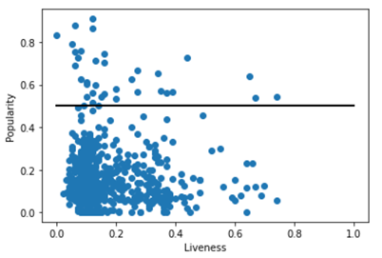
Testing
Notes:
Other features showed the popularity peaking more in the middle of the feature score, which lined up with our prior manipulation in tableau which produced bell curve trends on the features reliably.

Slide 13
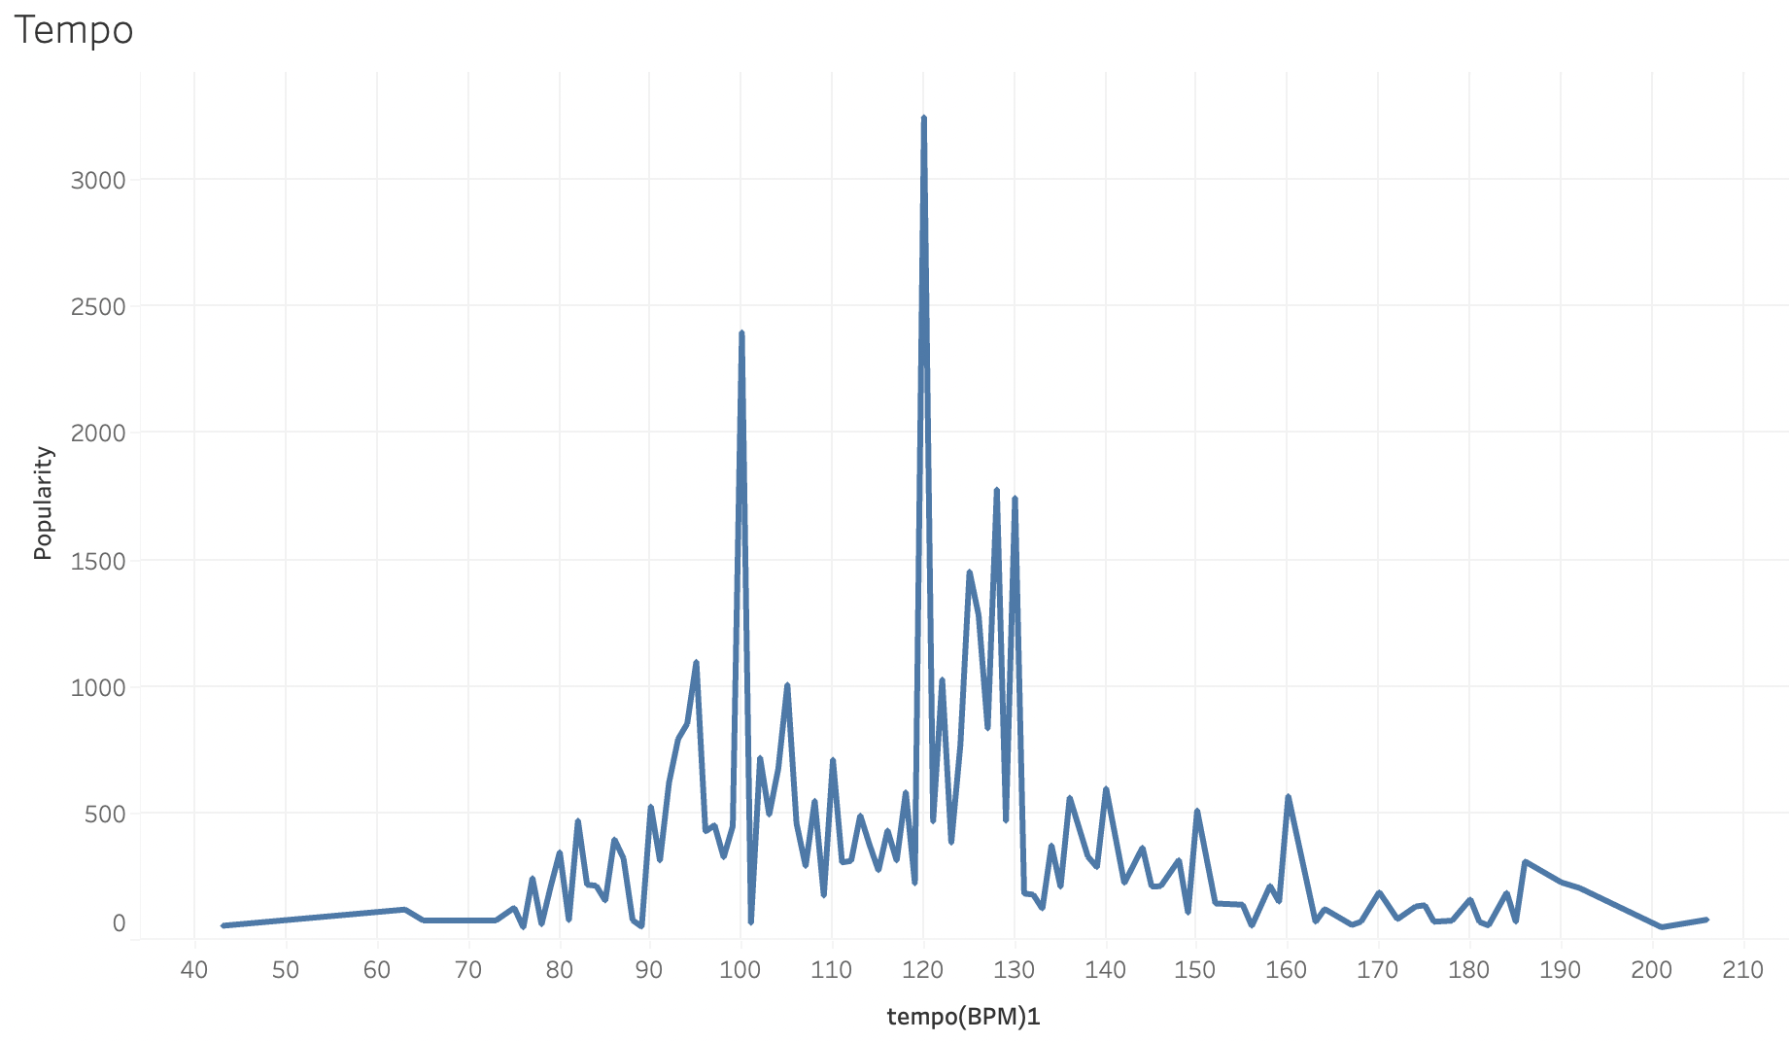
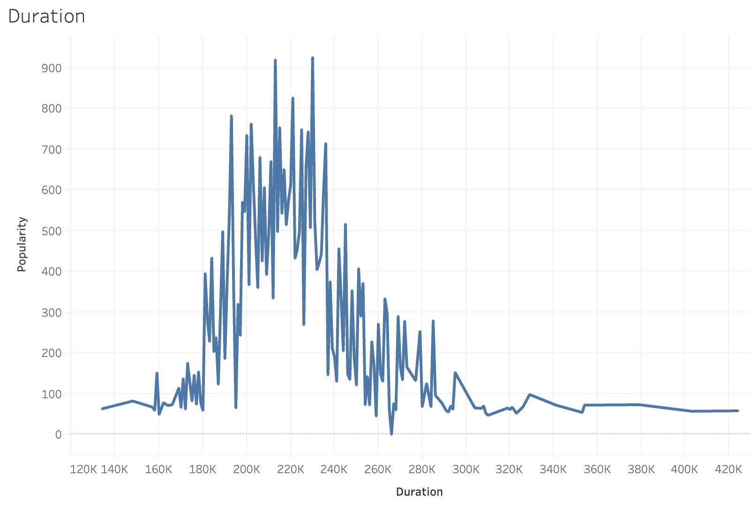
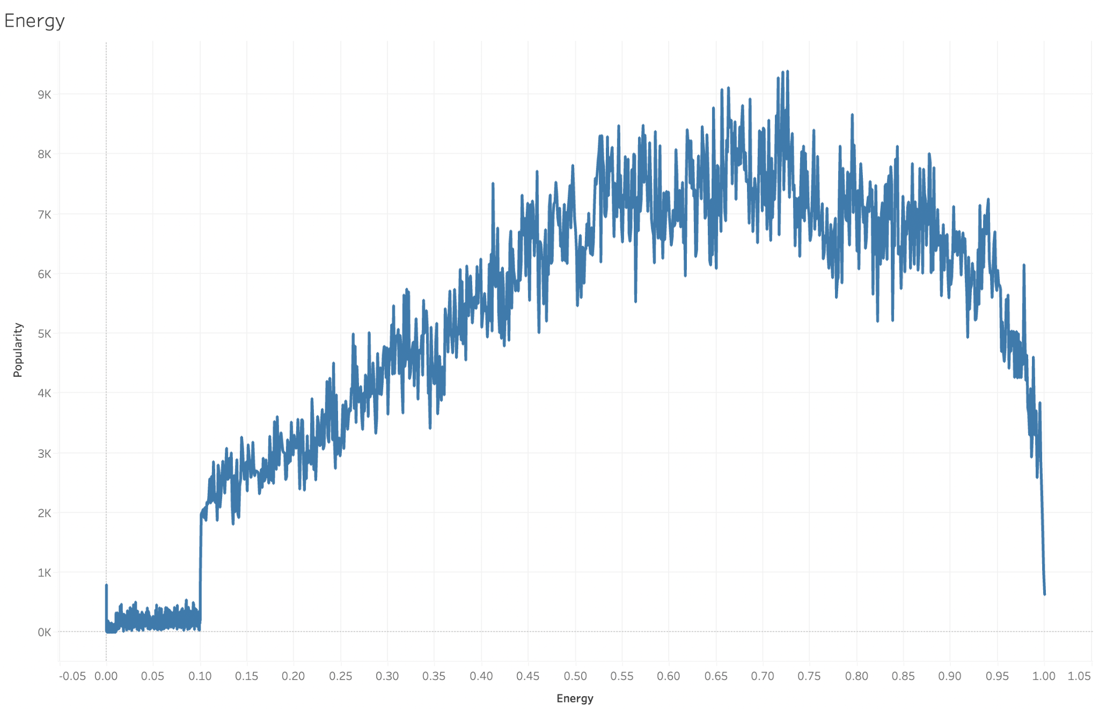
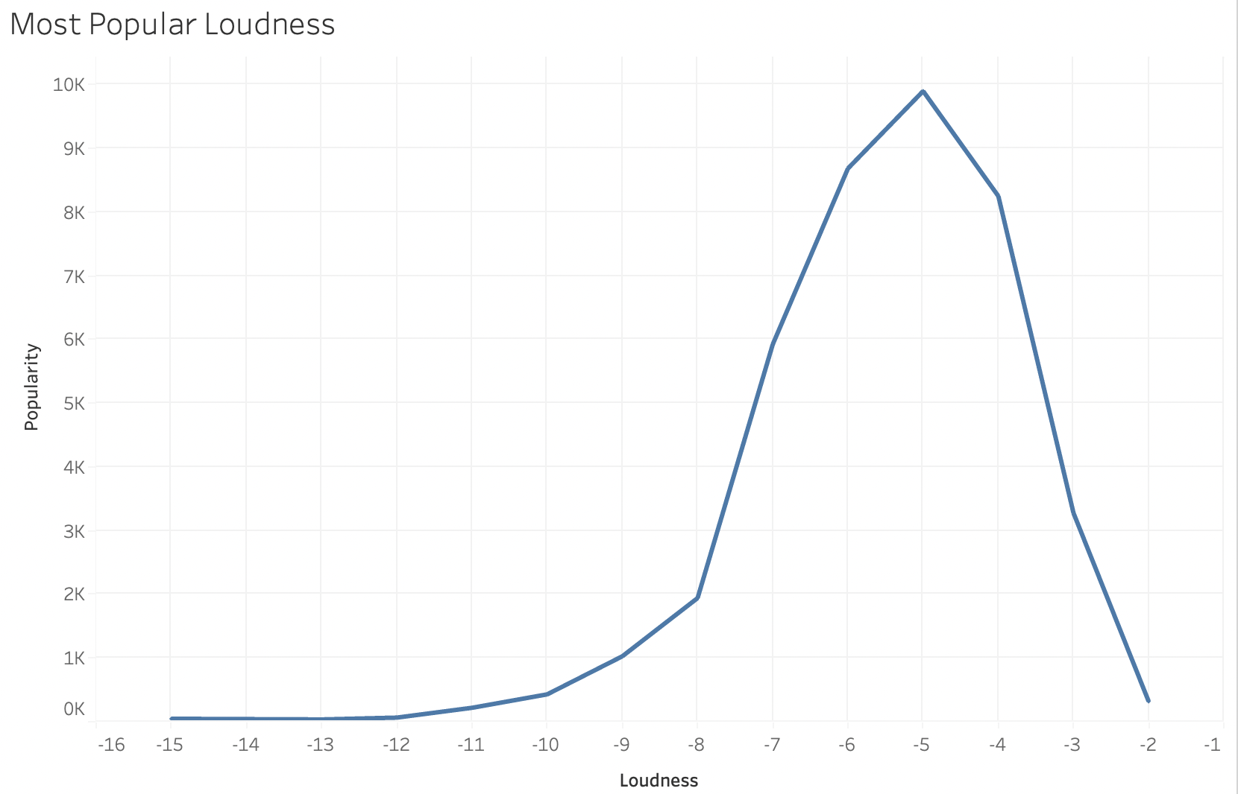
Tableau

Slide 14
Limitations of the Data
The Large Dataset contains a large variety of music from other nationalities, simple data manipulation revealed two of the most featured artists were from countries not considered for the smaller Dataset (Russia and Italy, respectively.)
All popularity scores were taken from a single timeframe, giving us only one dimension of popularity to determine if a song will be popular or not
These features do not account for the obvious requirement of talent, which is much harder to quantify with any accuracy.

Slide 15
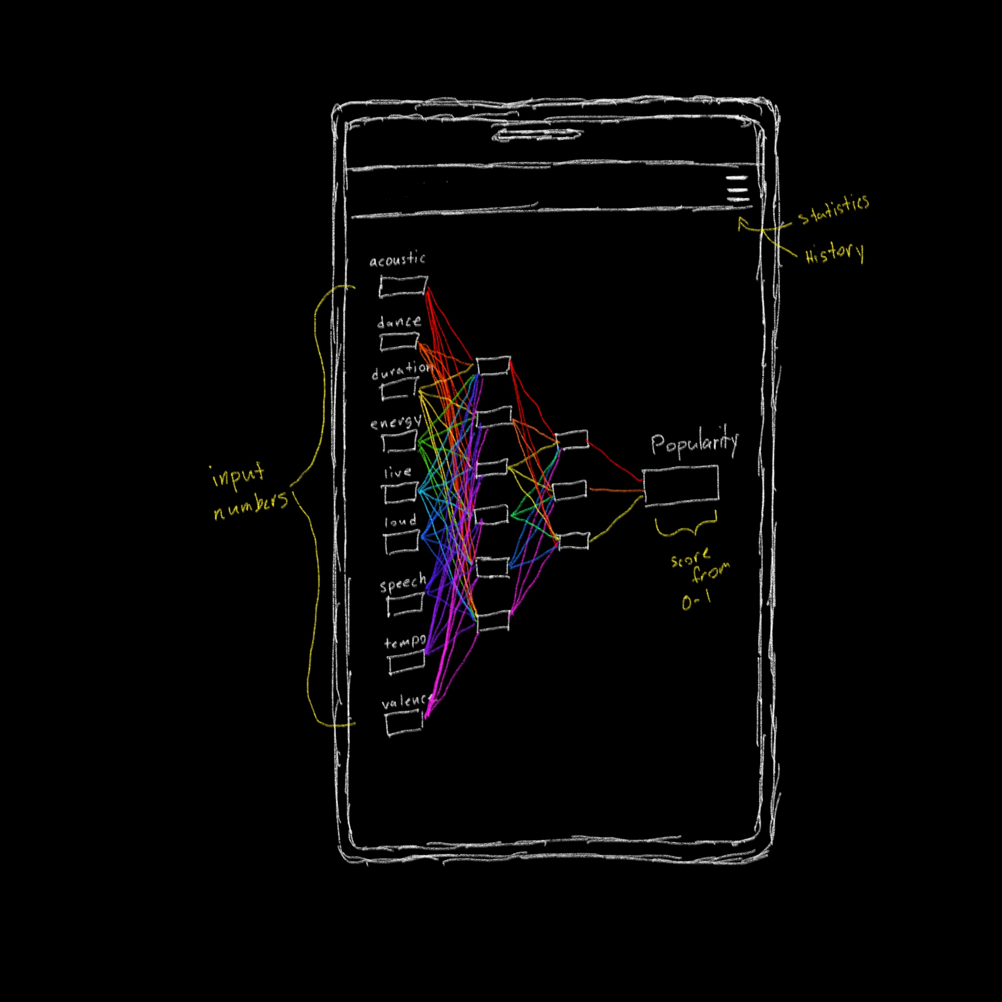
Future Application (Where we’d go next)
Creating a mobile app to input features and output predicted popularity.
Publish to https://research.atspotify.com/
Music Producers attempting to assess the popularity of songs they are producing.
Testing the likelihood of a jingle being effective to use in advertisement.
Using Billboard Top 100 charts to track trends in what features are becoming more influential ( faster songs, shorter songs, etc.)

Slide 16

Questions

